Slide 1
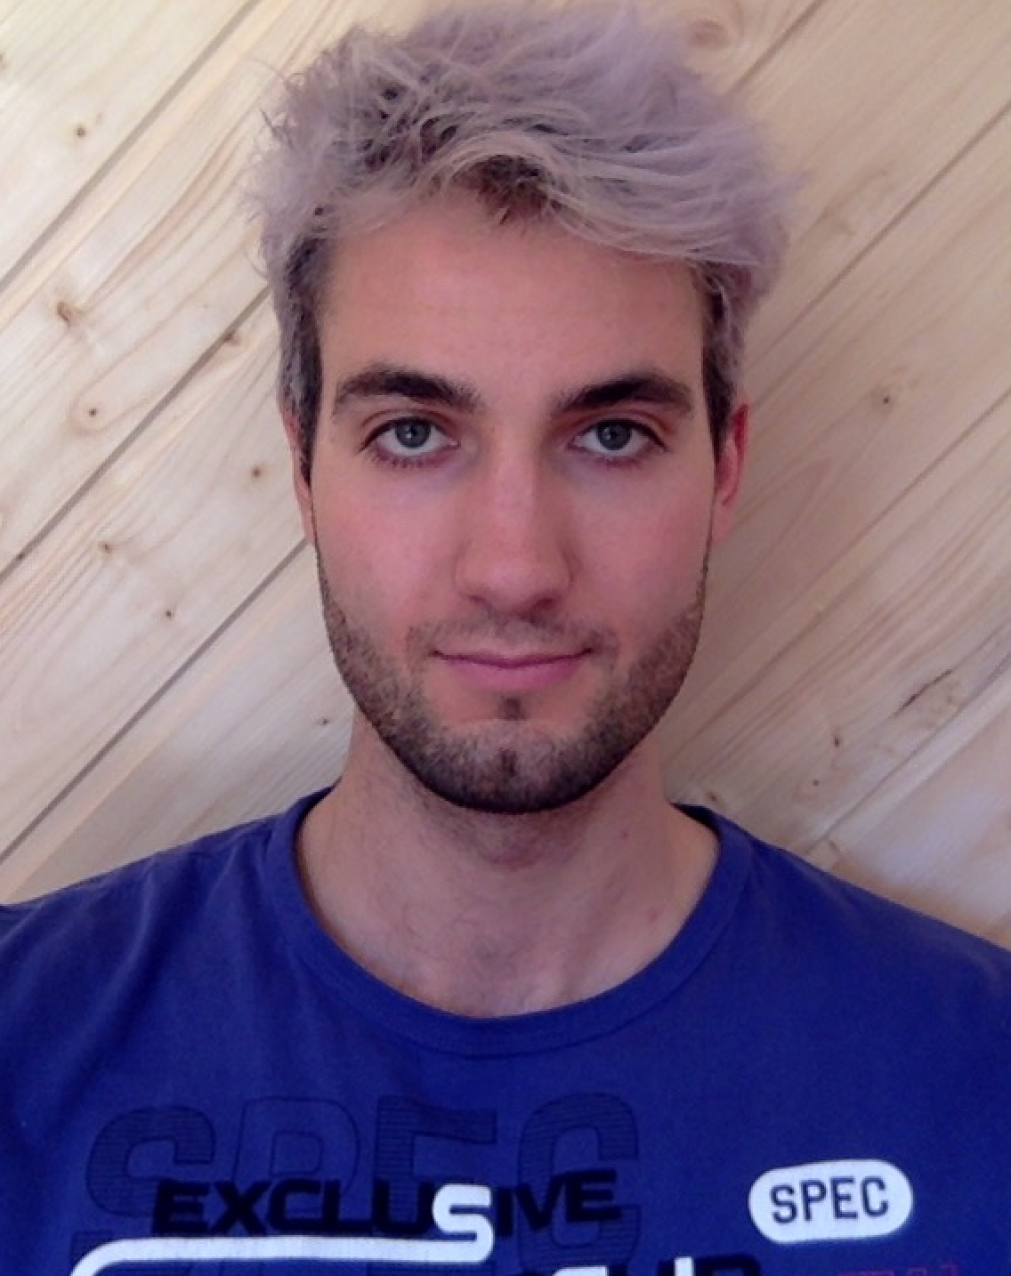
Human Live Pose Estimation Using PifPaf
Professor:
Student:
Assistant:
Alexandre Alahi
Jonathan Kaeser
Sven Kreiss
June 2019
Visual Intelligence for Transportation VITA : https://www.epfl.ch/labs/vita/

Slide 2
https://www.epfl.ch/labs/vita/

Slide 3
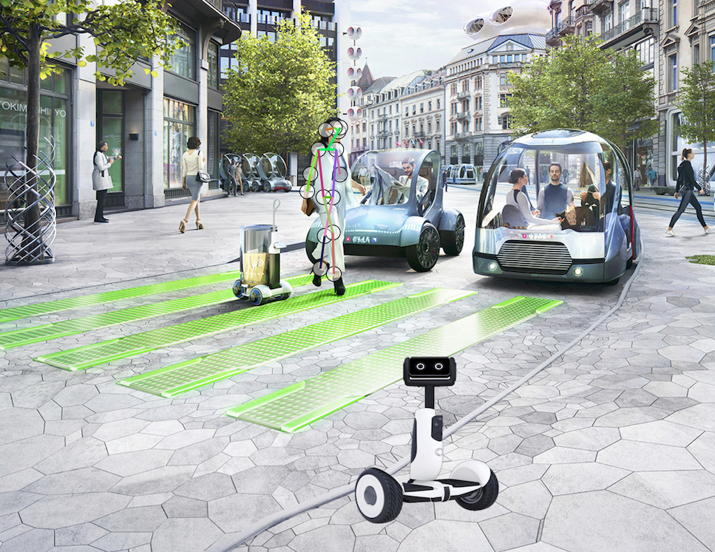
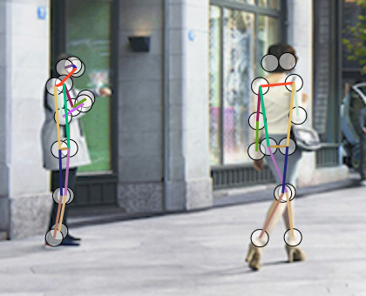
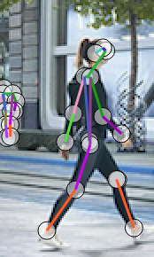
Use the PifPaf algorithm… (https://www.epfl.ch/labs/vita/research/perception/pifpaf/)

Slide 4
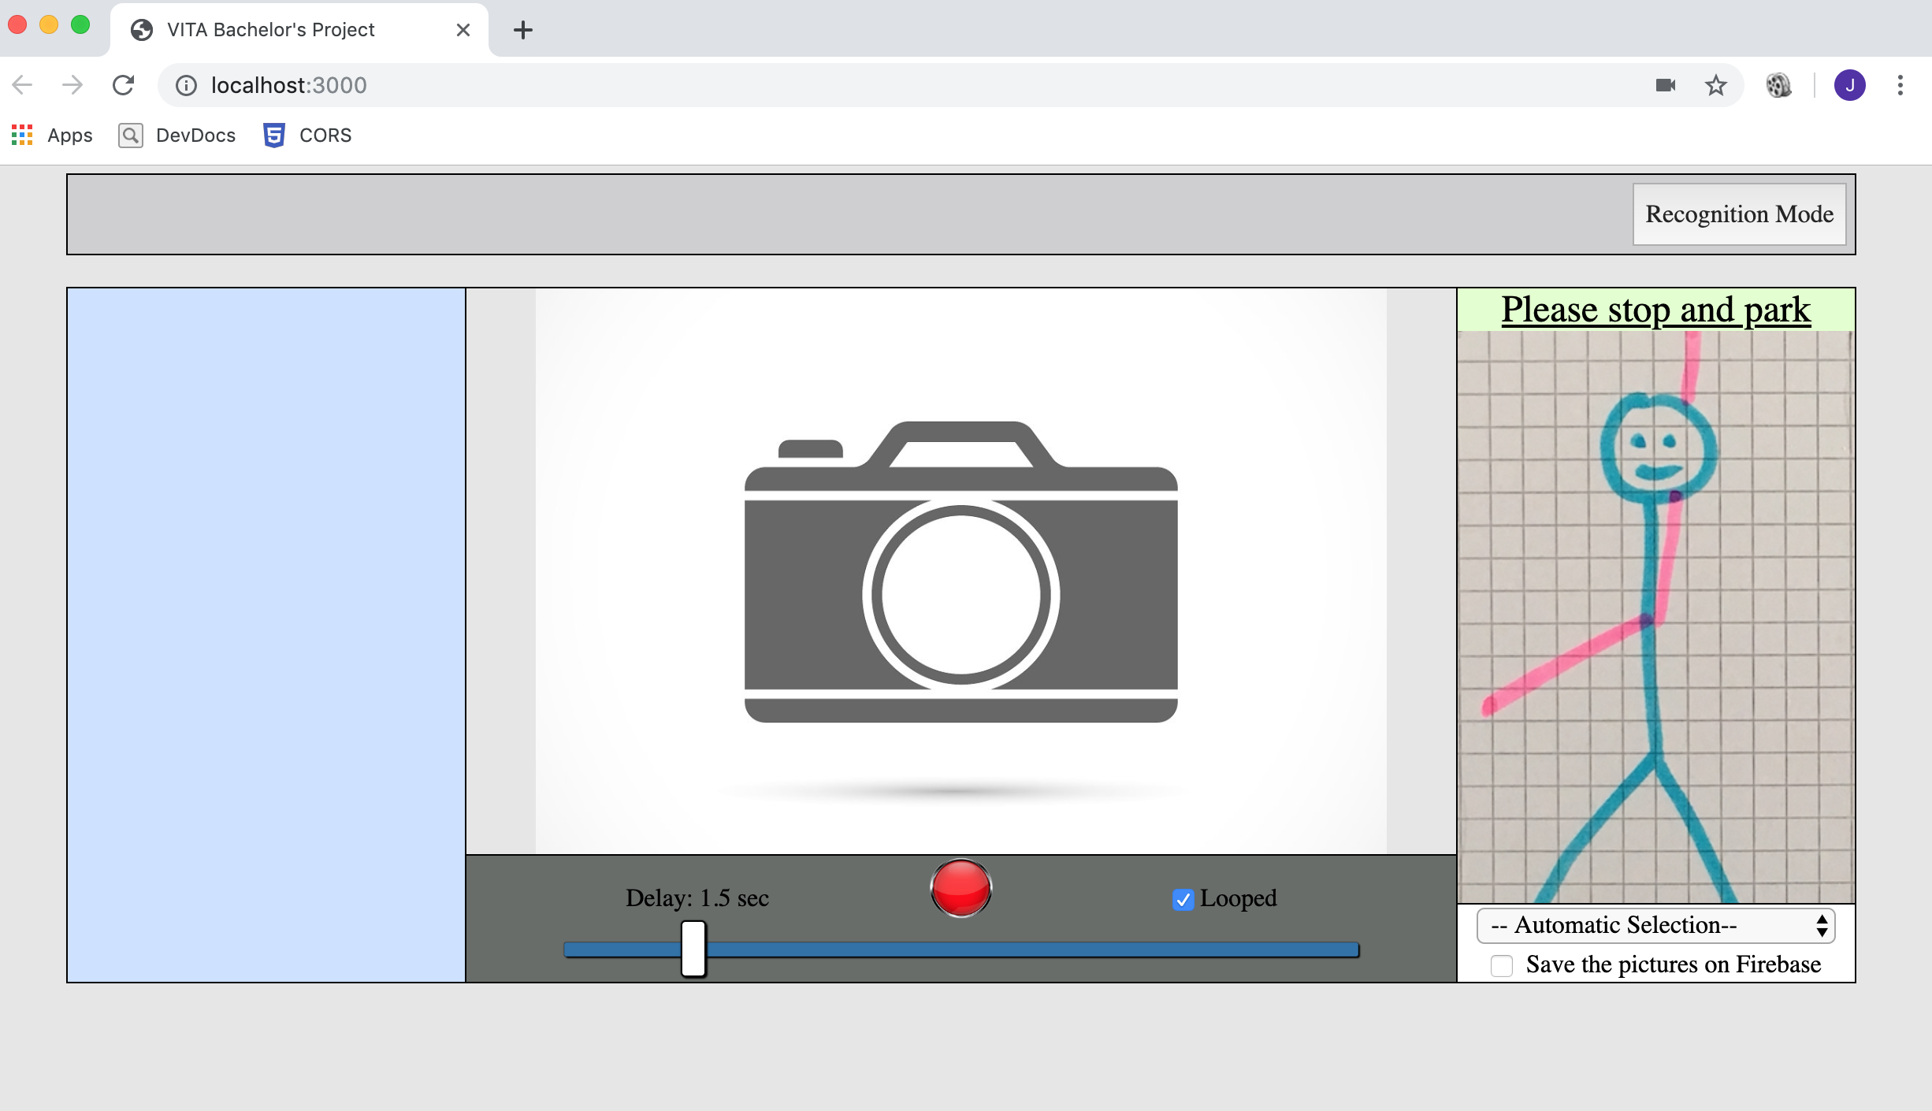
Use the PifPaf algorithm…
…in combination with a new interface…

Slide 5
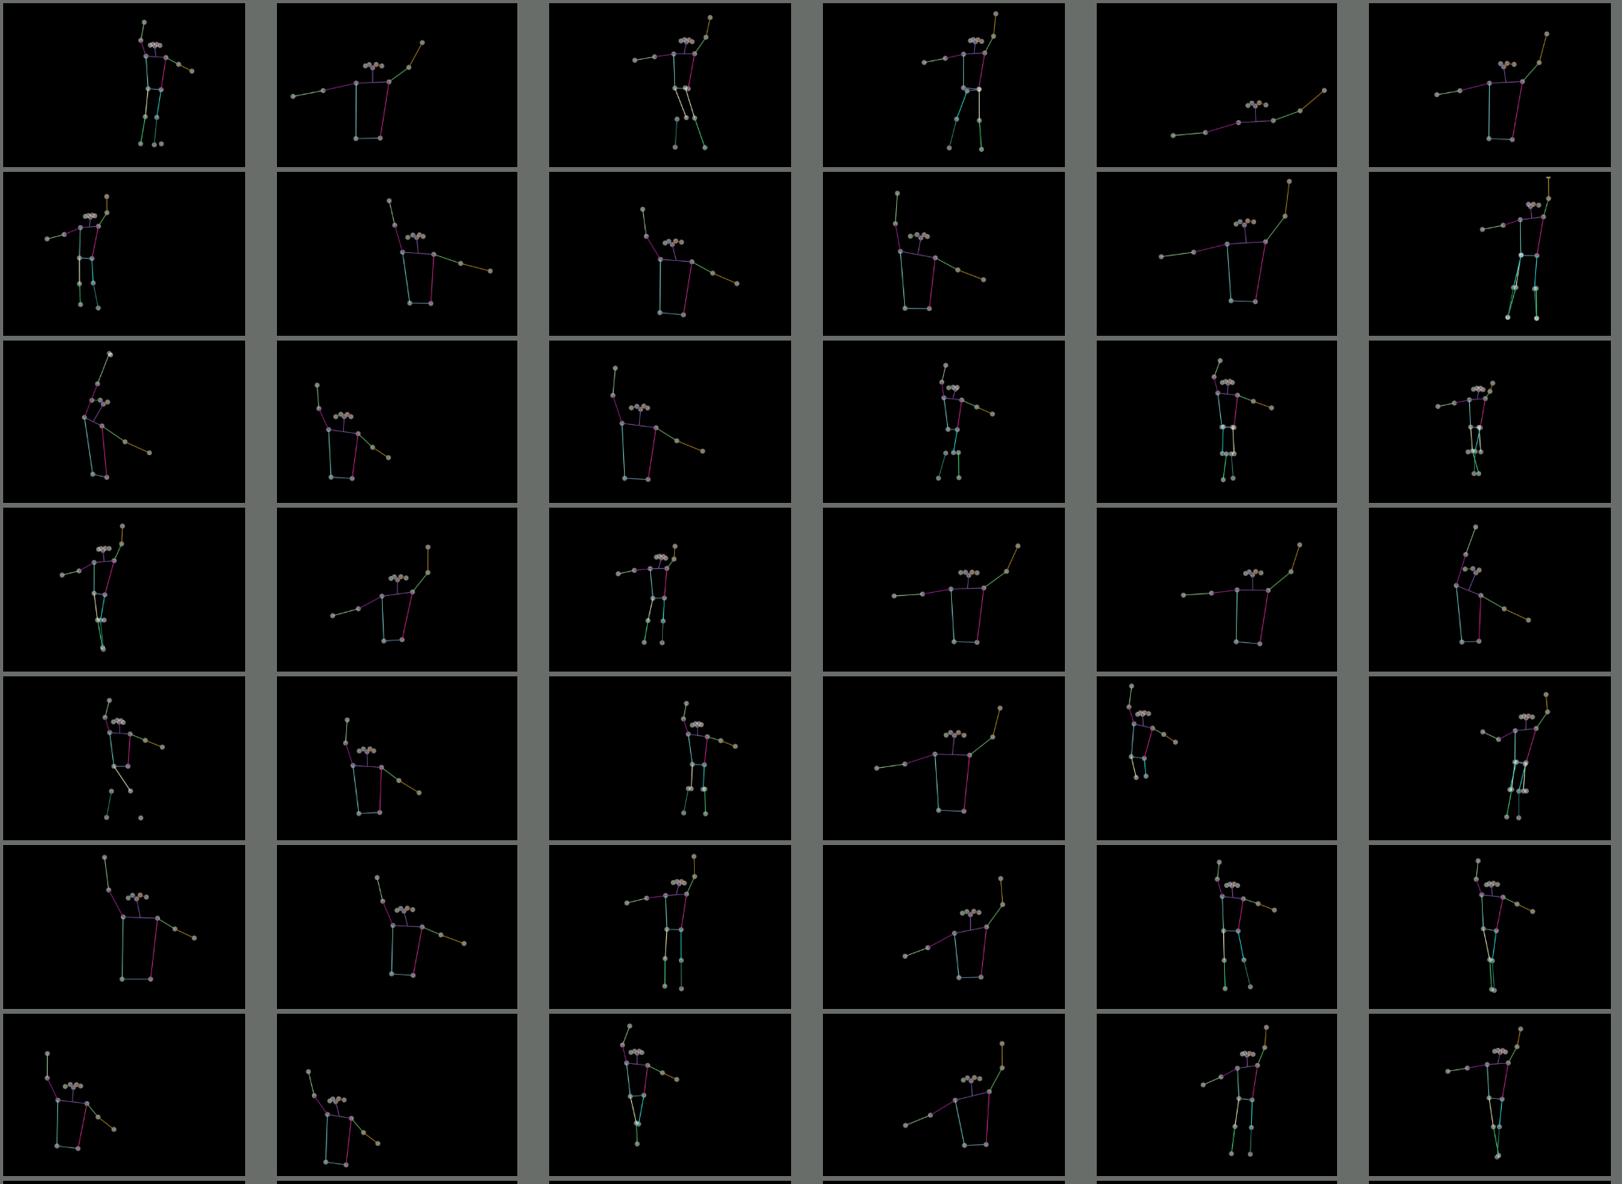
Use the PifPaf algorithm…
…in combination with a new interface…
… to get a training set …

Slide 6
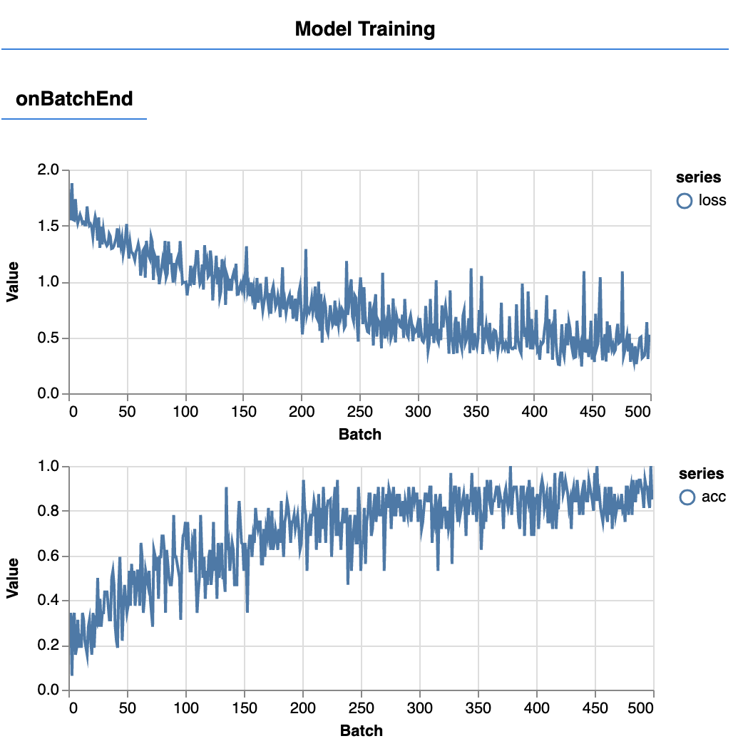
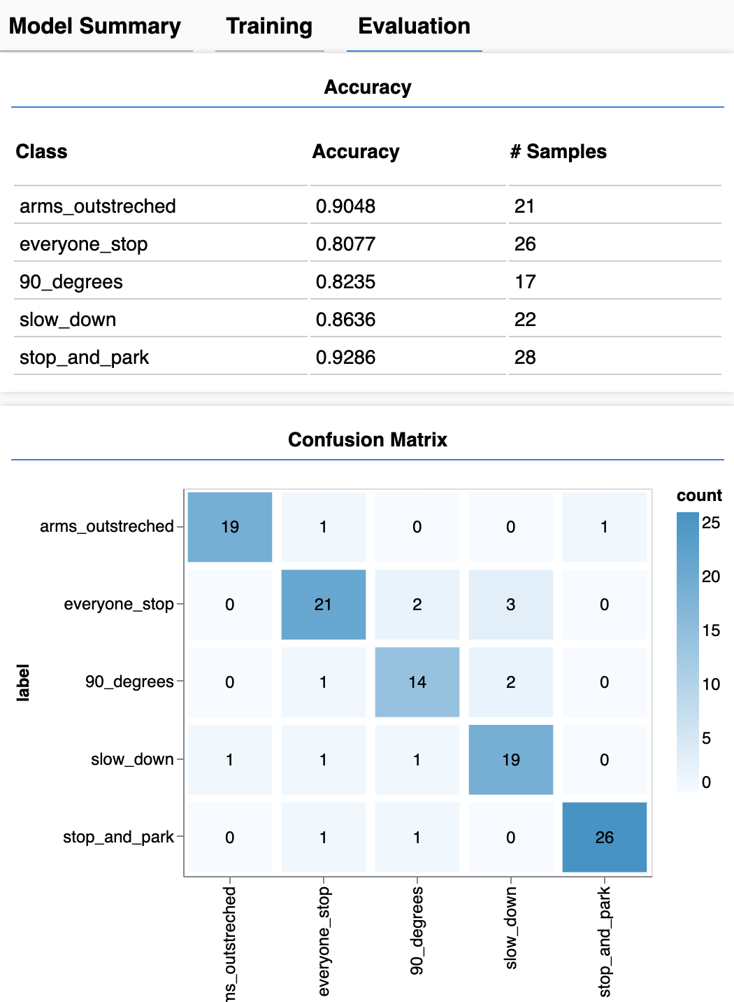
Use the PifPaf algorithm…
…in combination with a new interface…
… to get a training set .
Then train a neural network on top of it
…and finally integrate the result in the interface

Slide 7
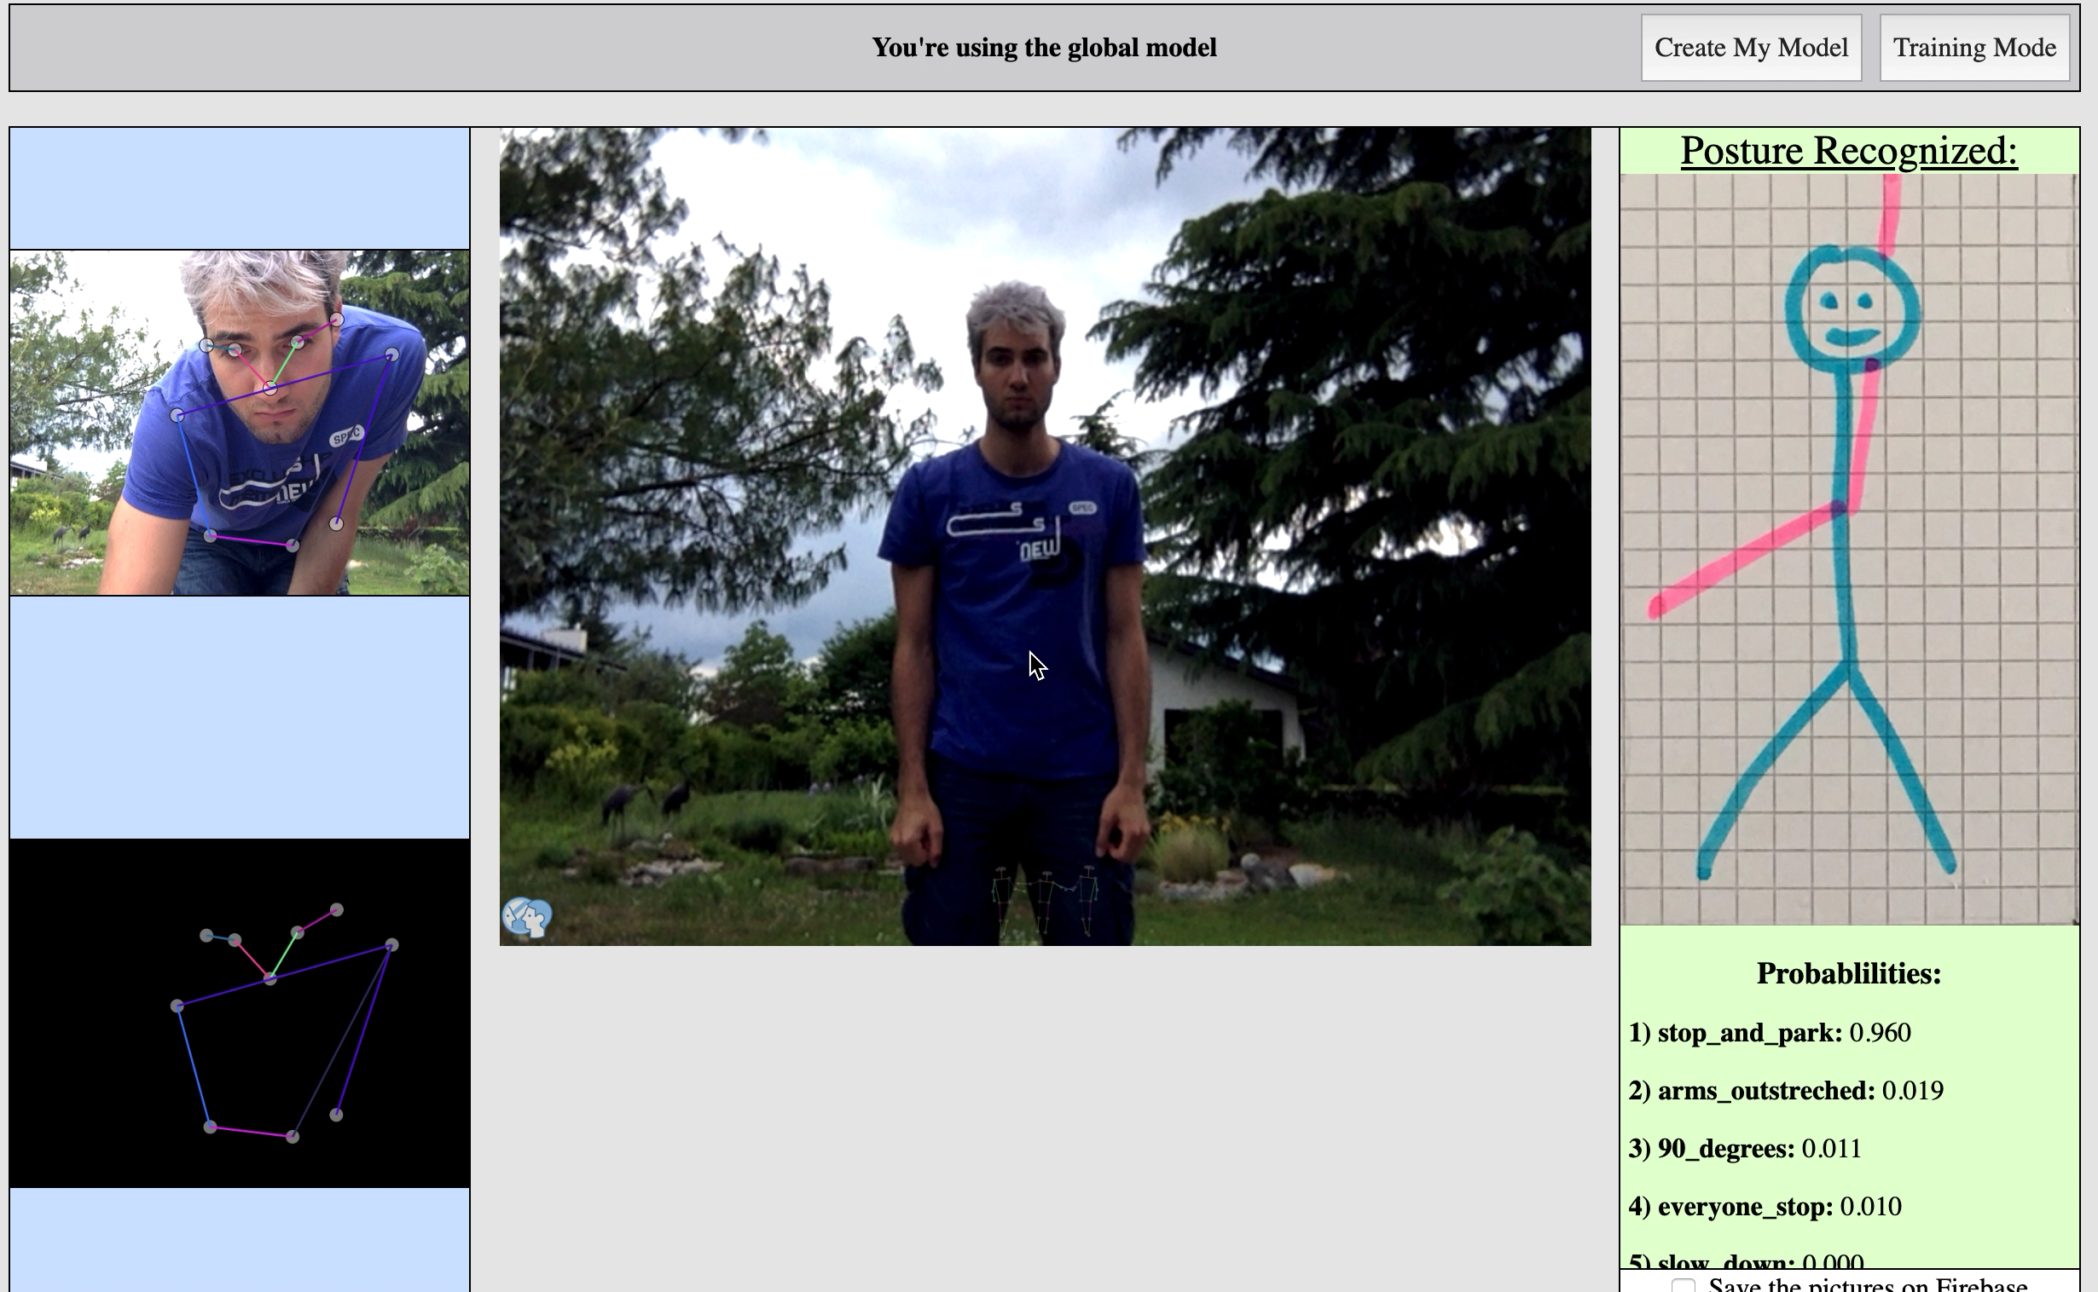
Use the PifPaf algorithm…
…in combination with a new interface…
… to get a training set .
Then train a neural network on top of it
…and finally integrate the result in the interface

